Slide 1


RSG MEDIA 05-03-2019
Insight Data Science fellowship is an intensive 7-week post-doctoral training fellowship
In New York, Silicon Valley, Boston, Seattle, Toronto, and Remote
Bridging the gap between academia & data science.

Slide 2

RESTAU ANALYTICS
https://dieudonne.shinyapps.io/RESTAUANALYTICS
Dieudonne Ouedraogo
Insight Data Science

Slide 3
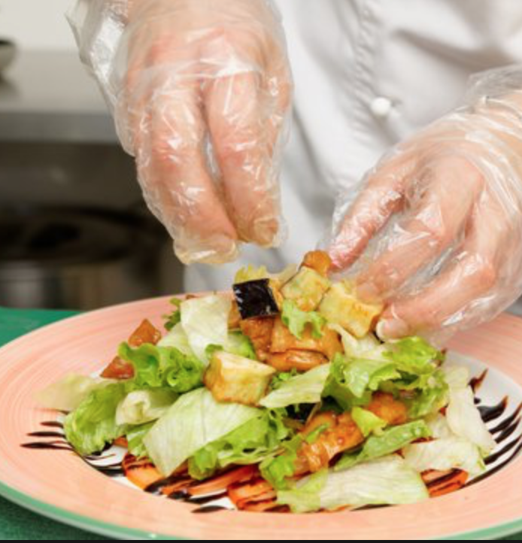
Motivation
Restaurants are regularly inspected and assigned violation ​scores
26K restaurants and 100 Inspectors
Managing this process is difficult

Slide 4


Violation points, Grades and Regulations
0-13 Points = "A"
14-27 Points = "B"
28+ Points = "C"
3 inspections of 28+
= closing of facilities

Slide 5
The Data
Inspection results 2010 to 2019
From NYC Open Data
385K Rows, 18 Columns

Slide 6
Raw Data 385K observations
CAMIS | INSPECTION DATE | ACTION | SCORE | GRADE | INSPECTION TYPE
40377630 | 1/17/2014 | Establishment Closed by DOHMH. Violations were cited in the following area(s) and those requiring immediate action were addressed. | 43 |  | Cycle Inspection / Re-inspection
40377630 | 1/21/2014 | Establishment re-opened by DOHMH | 2 | C | Cycle Inspection / Reopening Inspection

Slide 7
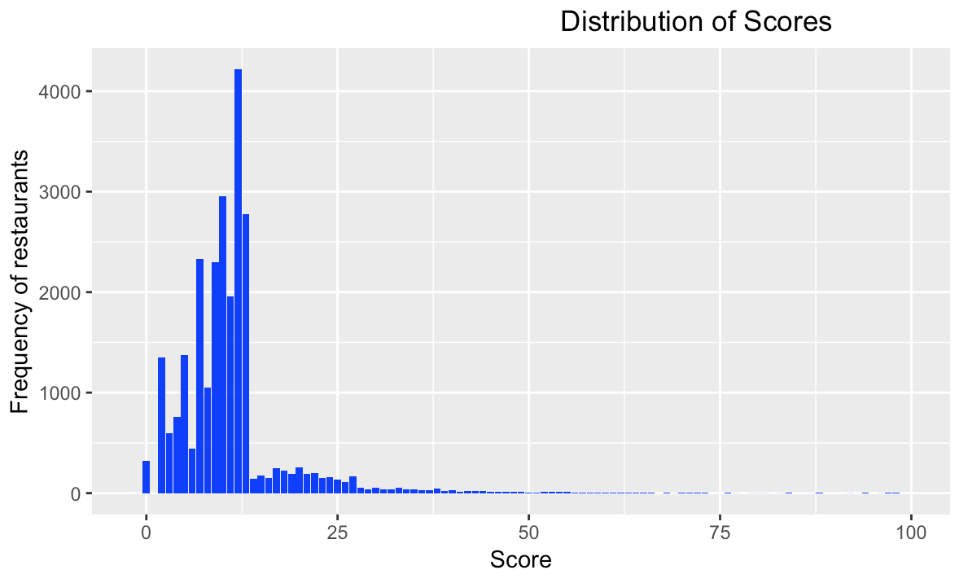
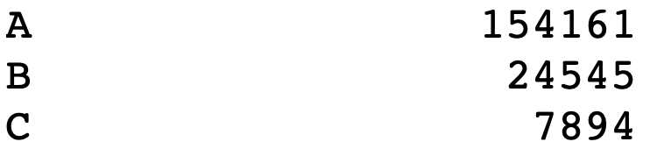
Distribution of Scores

Slide 8
Grades

Slide 9
Data Processing & Features Engineering
Inspection 30 | Inspection 31 | Inspection 32 | Inspection 33 | DBA | BUILDING | STREET | CUISINE.DESCRIPTION | BORO | ZIPCODE
31 | 29 | 7 | 27 | MORRIS PARK BAKE SHOP | 1007 | MORRIS PARK AVE | Bakery | BRONX | 10462
13 | 10 | 12 | 13 | WENDY'S | 469 | FLATBUSH AVENUE | Hamburgers | BROOKLYN | 11225
12 | 20 | 8 | 10 | DJ REYNOLDS PUB AND RESTAURANT | 351 | WEST 57 STREET | Irish | MANHATTAN | 10019
43 | 13 | 10 | 10 | RIVIERA CATERERS | 2780 | STILLWELL AVENUE | American | BROOKLYN | 11224

Slide 10
The Problem
0-13 Points
"A"
14-27 Points
"B"
28+ Points
"C"

Slide 11
The Priority
0-13 Points
"A"
14-27 Points
"B"
28+ Points
"C"

Slide 12
The Solution
Predict
Predict violation scores
Rule-based
Use “IF THEN” Condition
Retrieve
If true, restaurant belongs to priority

Slide 13

Predictions & Model Selection
We have a situation where previous inspections are highly correlated.
We also have a high number of features.
Random Forest performs well in these types of scenario.
The results of train/test and cross validation confirms the assumption.

Slide 14
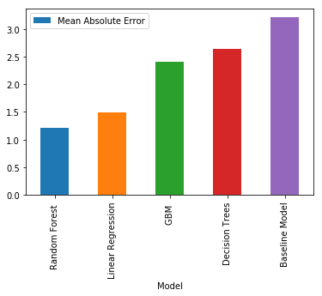
Testing and Validation

Slide 15
Model Interpretation
The first three inspections results are the most predictive variables used in the model
The third inspection result is the most indicative feature

Slide 16



Rule-Based Algorithm
We applied a rule-based (if …then) to get high priority cases
If last grade of restaurant < 14 and next grade is > 27
Restaurant is moving from A to C
If last grade of restaurant < 28 and next grade is > 27
Restaurant is moving from A or B grade to C grade

Slide 17
Results
The results show 280 restaurants moving from A or B to C grades. However, we have an absolute error of 1.21 points.
When this error is inserted into the decision boundaries of the rule-based algorithm, the results vary from 242 to 350.

Slide 18
Final Outcome
0-13 Points
"A"
192 restaurants
14-27 Points
"B"
28+ Points
"C"
359
88 restaurants
259 restaurants

Slide 19
The web-app
https://dieudonne.shinyapps.io/RESTAUANALYTICS

Slide 20
Conclusion
Using machine learning and a rule-based algorithm we were able to extract restaurants falling into bad grades where inspectors should go examine first.
The model predicts around 20% better than a baseline of using the last inspection score as the next score.

Slide 21

Extension to other businesses
A Excellent Customers
B Average Customers
C Customers close to defection
Use predictive models to extract signal from past interactions/ transactions
Retrieve those who will move from A or B into C
Target with incentives to stay

Slide 22
About Me
Ph.D. Systems Science (Applied Mathematics)
2016-2019
Graduate Teaching Assistant 2016-2018
M.S. Data Analytics 2014-2016
Worked in Retail 2002-2016
B.S. Computer Science & E.E 2001

Slide 23


END
THANK YOU

Slide 24
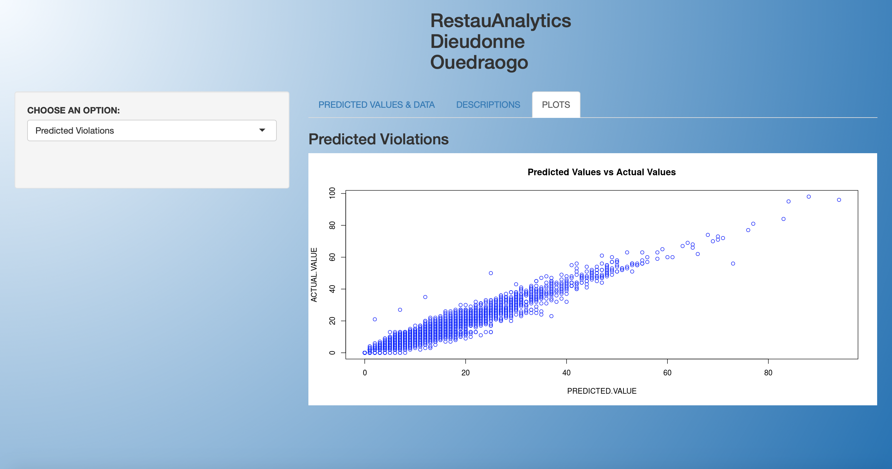

Slide 25
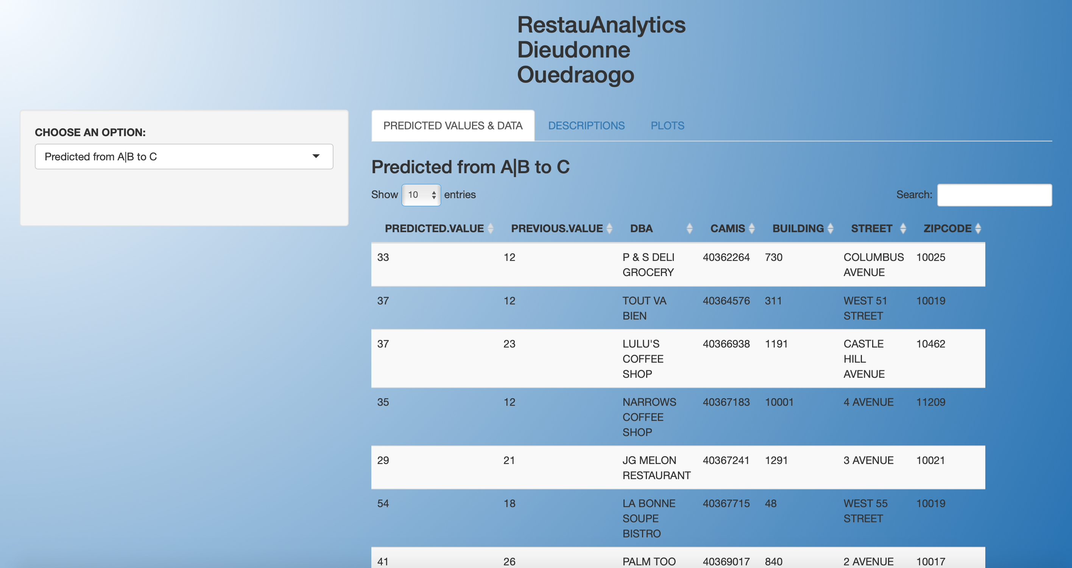

Slide 26
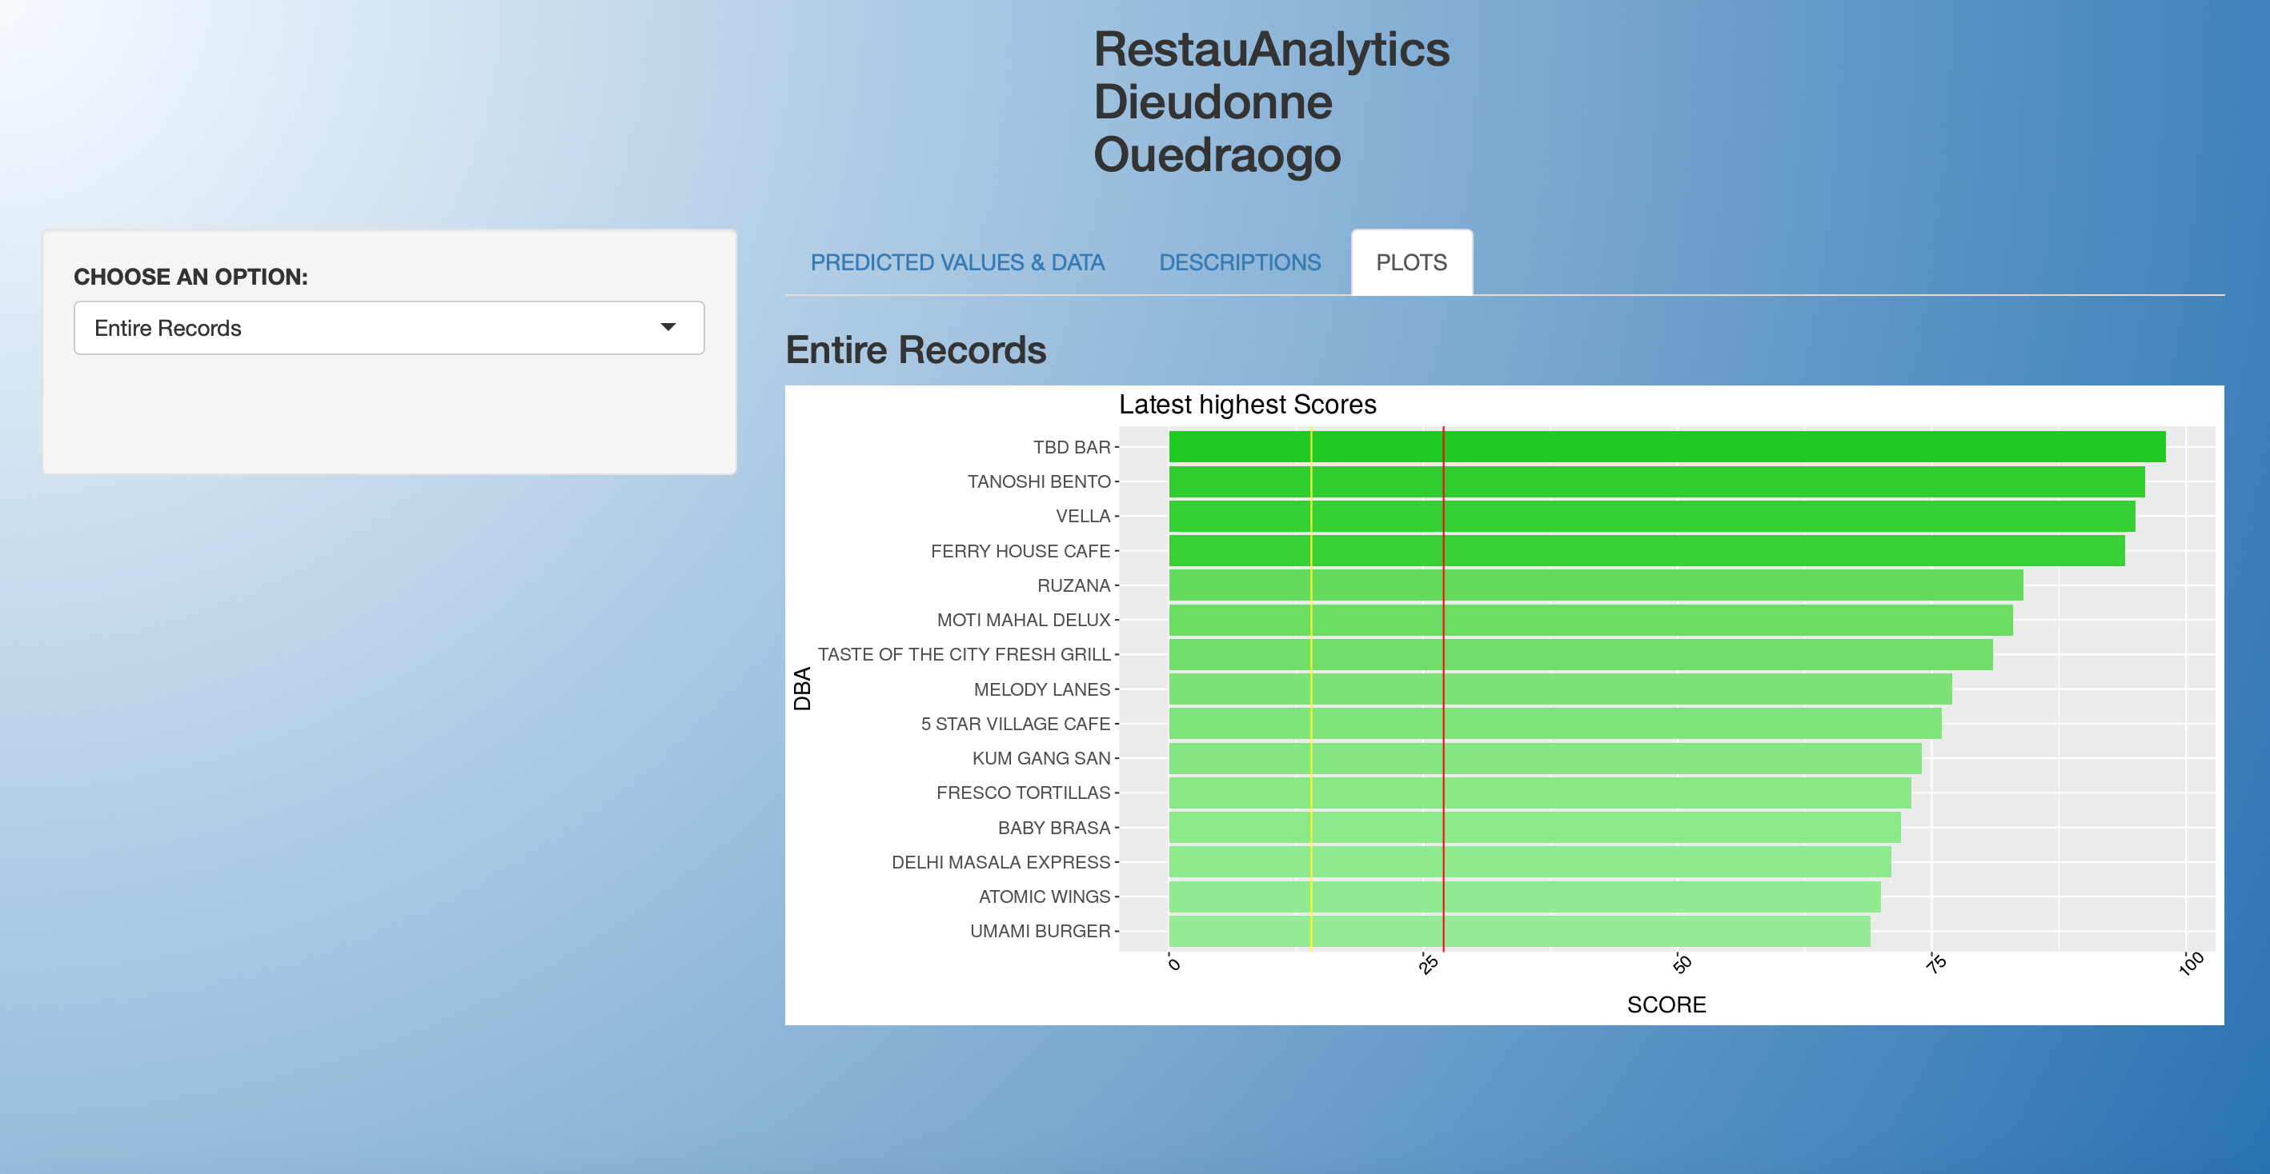

Slide 27
Appendix

Slide 28
Increase of Node Purity
IncNodePurity relates to the loss function which by best splits are chosen.
The loss function is mse for regression and gini-impurity for classification.
More useful variables achieve higher increases in node purities, that is to find a split which has a high inter node 'variance' and a small intra node 'variance'.

Slide 29
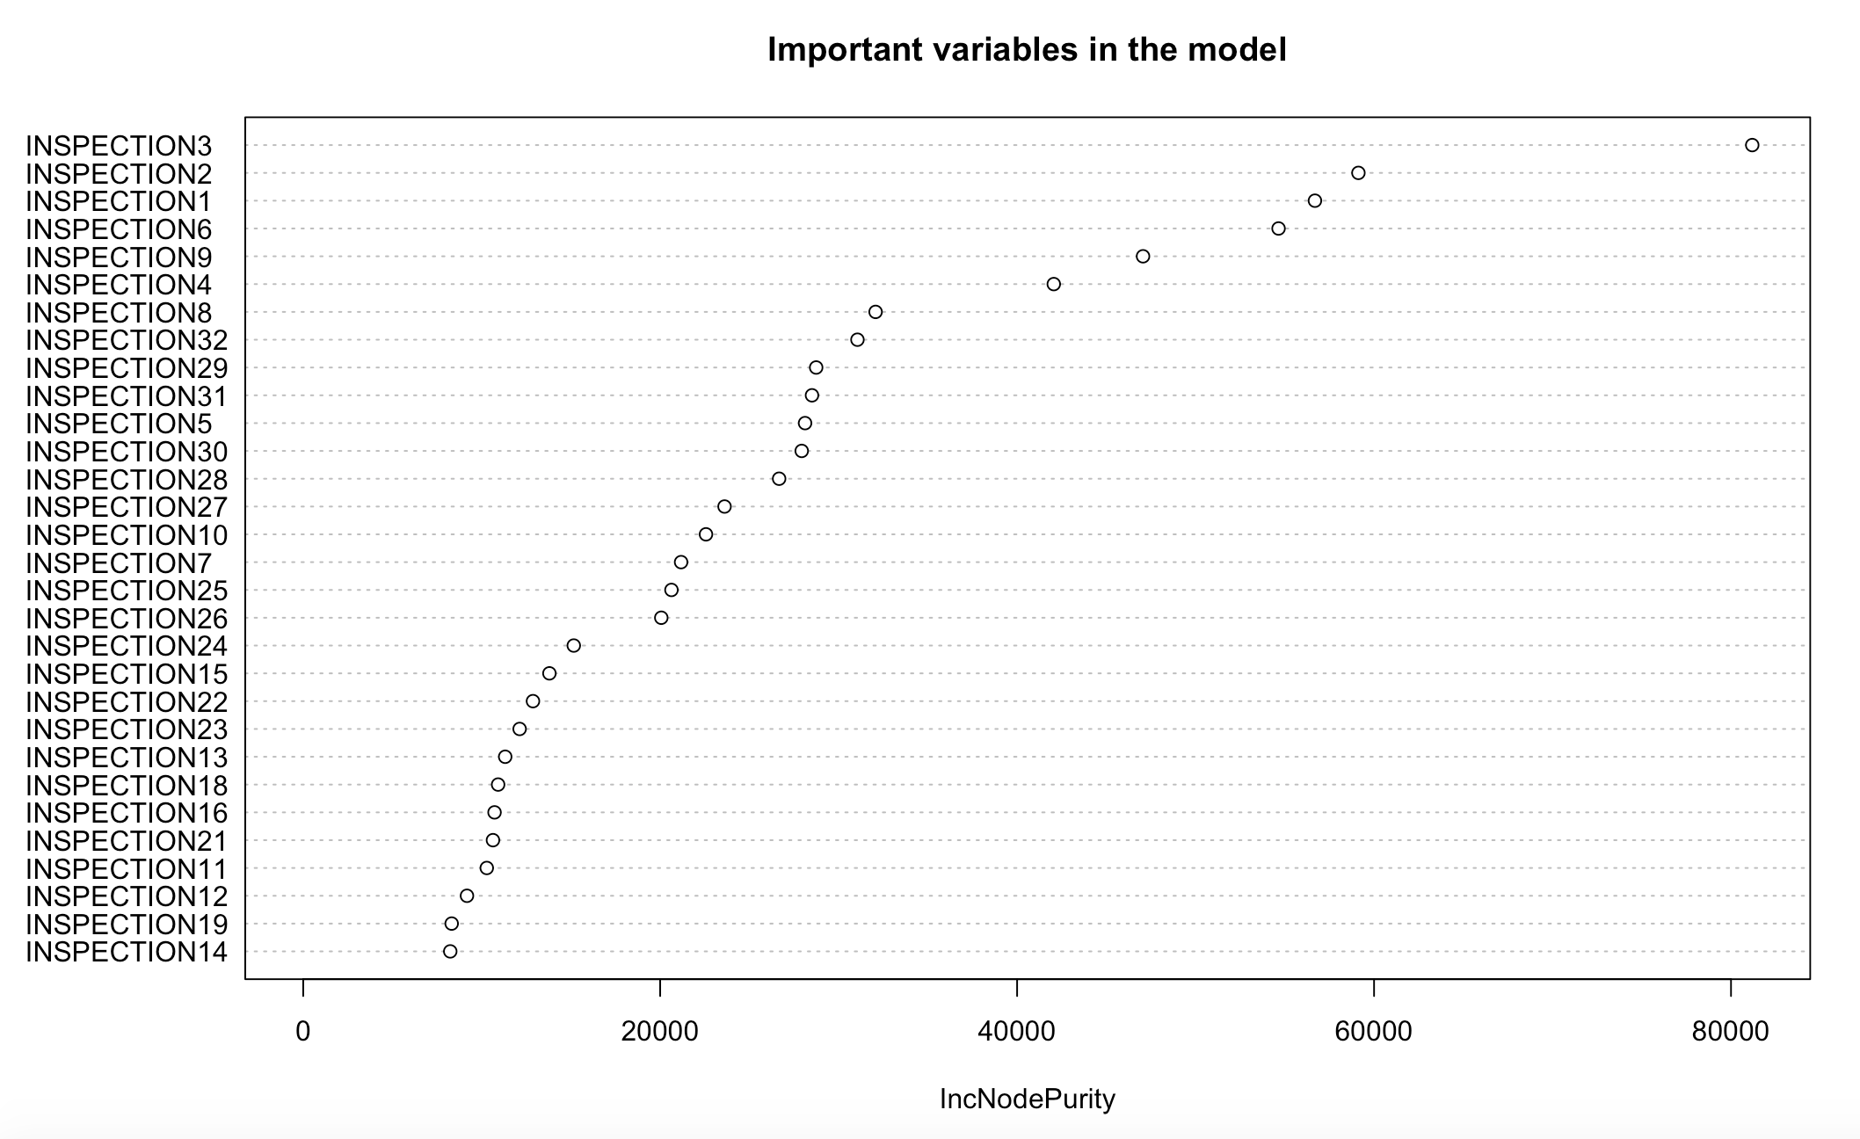
Variables Importance

Slide 30

FEATURES 1
SCORE Total score for a particular inspection
GRADE Grade associated with the inspection
GRADE DATE Date when grade was issued to the establishment (restaurant)
RECORD DATE Date record was added to dataset
INSPECTION TYPE A combination of the inspection program and the type of inspection performed

Slide 31
FEATURES 2
CAMIS
Unique identifier for the establishment (restaurant)
DBA Establishment (restaurant) name
BORO
Borough of establishment (restaurant) location
BUILDING Building number for establishment (restaurant) location
STREET
Street name for establishment (restaurant) location
ZIPCODE
Zip code of establishment (restaurant) location

Slide 32
FEATURES 3
PHONE Phone number
CUISINE DESCRIPTION Establishment (restaurant) cuisine
INSPECTION DATE
ACTION
Action associated with each establishment (restaurant) inspection
VIOLATION CODE Violation code associated with an establishment (restaurant) inspection
VIOLATION DESCRIPTION
Violation description associated with an establishment (restaurant) inspection
CRITICAL VIOLATION Indicator of critical violation

Slide 33
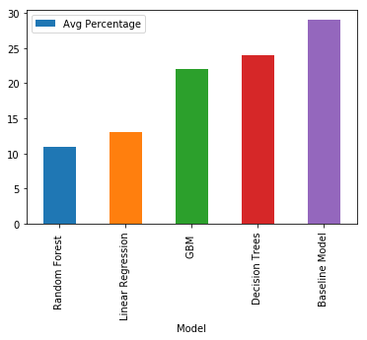
Percentage compared to mean score

Slide 34
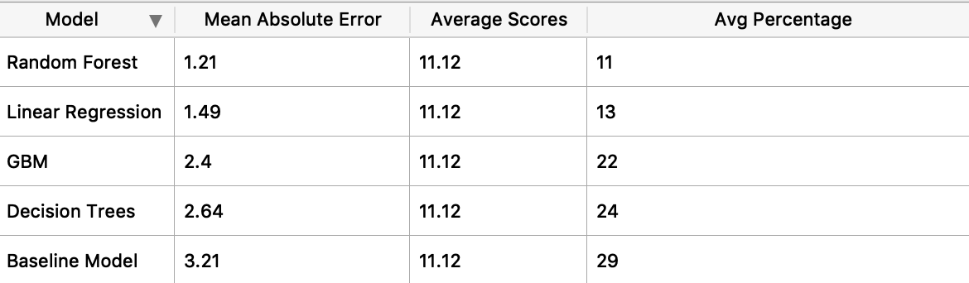
Errors

Slide 35
The Algorithm
Predict all future scores using Random Forest
Based on predicted score
Go through all observations
If restaurant is moving from Class A to class C :
retrieve observation
If restaurant is moving from B to C
retrieve observation

Slide 36
Choosing Random Forest
Correlated features, no overfitting, very noisy dataset with many missing values
GBM doesn’t perform well with noisy dataset and huge missing values
Why ordinal +RF better than time series: Too many missing values, irregular steps
Observations asynchronous
Distribution of time between inspections is random
how robust is your predictions: Very robust as it take the average of many trees predictions.

Slide 37
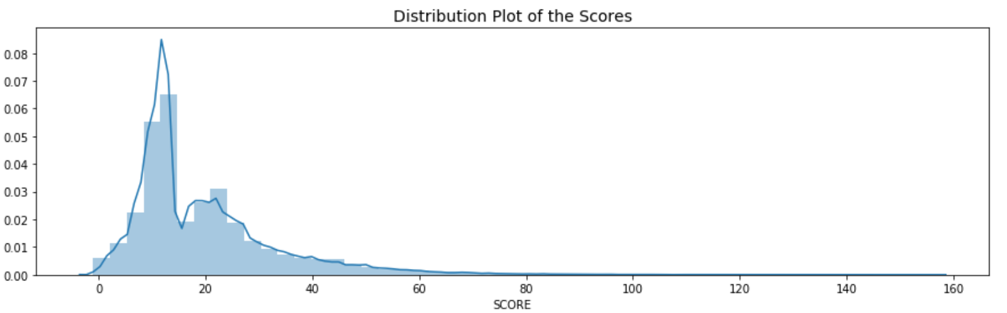
Distribution of score across restaurants

Slide 38
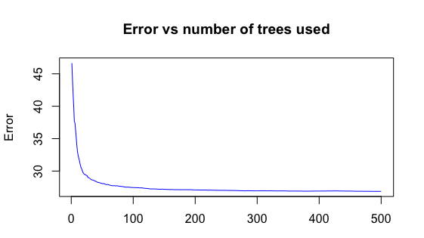
Error vs trees in Random Forest

Slide 39
Grades in Borough

Slide 40
Most Frequents violations code
10F Non-food contact surface (53950)improperly constructed. Unacceptable material used. Non-food contact surface or equipment improperly maintained and/or not properly sealed, raised, spaced or movable to allow accessibility for cleaning on all sides, above and underneath the unit.
08A Facility not vermin proof. (41553) Harborage or conditions conducive to attracting vermin to the premises and/or allowing vermin to exist
04L Evidence of mice or live mice (28100) present in facility's food and/or non-food areas

Slide 41
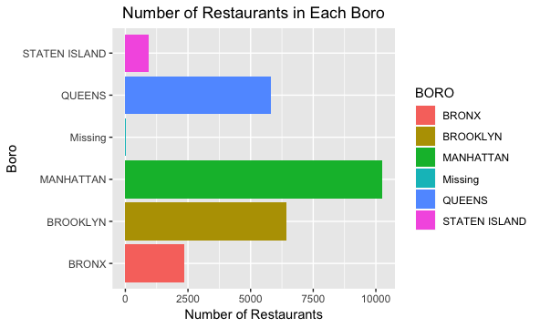
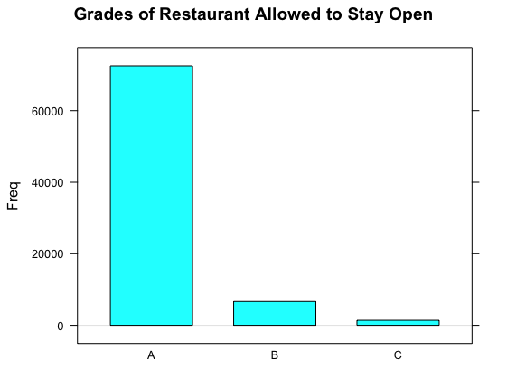
Grades & Restaurants

Slide 42
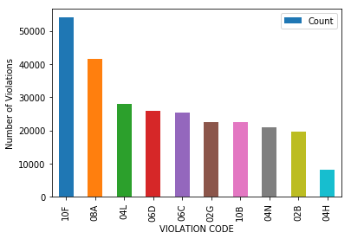
The 10th highest violation codes

Slide 43
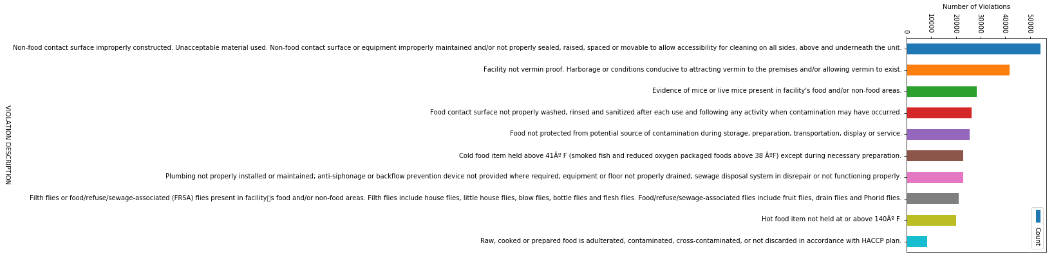
Violations

Slide 44
Reference
https://www.nytimes.com/2018/06/05/dining/new-york-restaurant-inspections-by-the-numbers.html
26,101 Restaurants subject to New York City health department inspections (as of December 2017)
40,700 Total inspections (in 2017)
About 100 Restaurant health inspectors today
22,185 Restaurants with A grades (in April)

Slide 45
Records
1,256 Restaurants with Bs
315 Restaurants with Cs
1,019 Restaurants closed because of unsanitary conditions (in 2017)
4,670 Restaurants with violations, at most recent inspection, related to mice (as of December 2017)
1,325 Restaurants with violations, at most recent inspection, related to cockroaches
About 22,600 Restaurant supervisors completing health department food-protection course in 2010, when letter grading began

Slide 46
Inspections Timeframe
If you receive 14-27 points, on either the initial or re-inspection you will be on a 150-210 day cycle
01
If you receive 28 or more on either the initial or re-inspection, you will be on a 90-150 day cycle.
02
However a score of 28 or more on the re-inspection will have an additional compliance inspection that will not lead to changing the letter grade or cycle.
03

Slide 47
CRITICAL VIOLATION
Food Temperatures
Improper Cooking is a 10 or 28 point violation only. 10 points if they find it; 28 if it is not Corrected During the Inspection
Improper Hot Holding 5-8 points based on the number of foods in violation
Cold holding above 41°F for most foods includes garlic in oil, or above 38°F for ROP foods and smoked fish
Foods prepared from ambient ingredients below 41°F in 4 hours or less

Slide 48
Critical violation
Food Sources
01
Dirty or cracked eggs, ranging from 1-25 by groups of 6, points of 7-28
Food Protection
02
Three compartment sinks will be needed in all facilities
Closed drink containers are not allowed to contaminate the food stream.
Wet cloths in sanitizer at the proper concentration and test strips are available
Presence of vectors and evidence of vectors in varying degrees ranging from 5-28 points

Slide 49
Critical violations
Facility Design
Overhead dust and dirt that could contaminate foods
Sneeze guards, wrapped portioned products
Proper thermometers or thermocouples
Food contact surfaces constructed, located or unacceptable materials
Food contact surfaces are to be WASHED RINSED and SANITIZED in place after each use
Personal Hygiene
Ill employees will be worth 10 points and failure to remove them will result in 28 points
All employees working with ready to eat foods are using gloves
Improper hand washing
There is a sliding scale that increases the points associated with the violations, ranging from 5-28 points.

Slide 50
The methodology part 1
Group data by restaurants ID
Within a restaurant
Index each score position with n
Retrieve the score into a variable Vn
At the end restaurants will have different numbers of inspections
Pick the maximum number of inspections which is in this case 33
Order scores by inspection date
Do the same for all the restaurants

Slide 51
Methodology part 2
Since restaurants don’t have the same number of inspections, there will be missing values.
I decided to keep the entire dataset and to impute the missing values by the row average of the restaurant own score.
To preserve the order of inspections, inspections scores should moved to the right if there are missing values in a row
Do the imputation of the missing values.

Slide 52
Methodology part 3
To be able to measure the effectiveness of the process, we will use the last inspection V33 as the target, and use the scores V1 to V32 as input variables, but once the model is built and well tested, we plug V2 to V33 as inputs to the predict the next score.
Use the rule-based step to retrieve the values of high priority

Slide 53
END
THANK YOU

